Slide 1
Summary of a comparison of machine learning methods for classification using simulation with multiple real data examples from mental health studies
Journal Club – 08.06.2020

Slide 2
Background

Slide 3
Method
STUDY design

Slide 5
Method
Simulation

Slide 6
Simulation
Goal: generate realistic gene expression data with variation in variability, effect size, correlation, etc. to investigate effects of such data characteristics on performance of classification algorithms
Base expression levels
From real microarray data
Random effects model
Introduce between-subject (biological) and within-subject (technical) variation
Block-diagonal correlation matrix
Models network relationships (e.g. genes working together to perform a biological function)
Introduce group difference
Divide training sample into G1 + G2 (same size)
G2 up-or down regulated with factor zδ (δ = effect size (unstandardised group difference), z $∈\{−1,1\}$ )
G2 up-or down regulated with factor zδ (δ = effect size (unstandardised group difference), z ∈{−1,1} )

Slide 7
Results
Results on main simulation

Slide 8
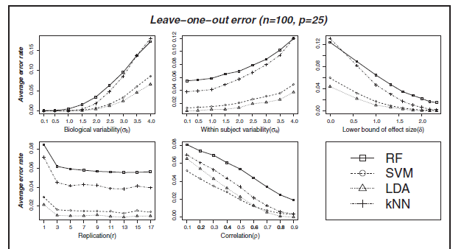
n = training sample size, p = feature set size
Notes:
Was wird gezeigt:
Average leave-one-out cross-validation estimate of classification error over the 500 replications of simulated datasets for all the four methods (RF, SVM, LDA and kNN) plotted against the values of the various data characteristics
Other variables are fix, if not on the x-axis
Je geringer average error rate desto besser is Methode:
Interpretation:
optimal performance conditions for LDA, in which case it outperforms all the other methods studied here, are smaller feature set size (relative to training sample size) and higher correlation (p>0.6) between features
As the feature set gets larger SVM outplays LDA and also performs better than RF and kNN

Slide 9
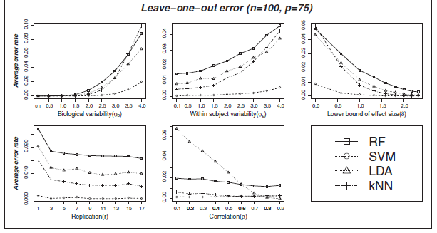
n = training sample size, p = feature set size
Notes:
Je geringer average error rate desto besser is Methode:
Interpretation:
SVM outperforming other methods by a clear margin with highest performence differece at higher data variability, sammler effect size and smaller correlation
kNN improves as feature set size grows (outperformes LDA and RF) unless data variability it too high and/or effect size is too small

Slide 10
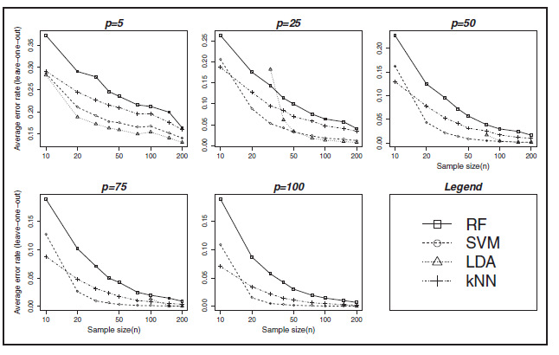
Notes:
Was wird gezeigt:
error rates plotted against nine different values of n as given in Table 1 for five different values of p (feature set size): 5, 25, 50, 75 and 100
Interpretation: - SVM performed better than other methods (see plots before) but just for larger n and p, !!!not well for smaller values of n (see figures here)
Conculsion: For SVM to perfom good n at least 20 (irrespective to numer of variables p)
The error rates for LDA are not shown for sample sizes smaller than the number of variables (p) as the method is degenerate for p > n
Conclusion: n at least 2p for LDA to have comparable performance
-

Slide 11
Results
Results on real data

Slide 12
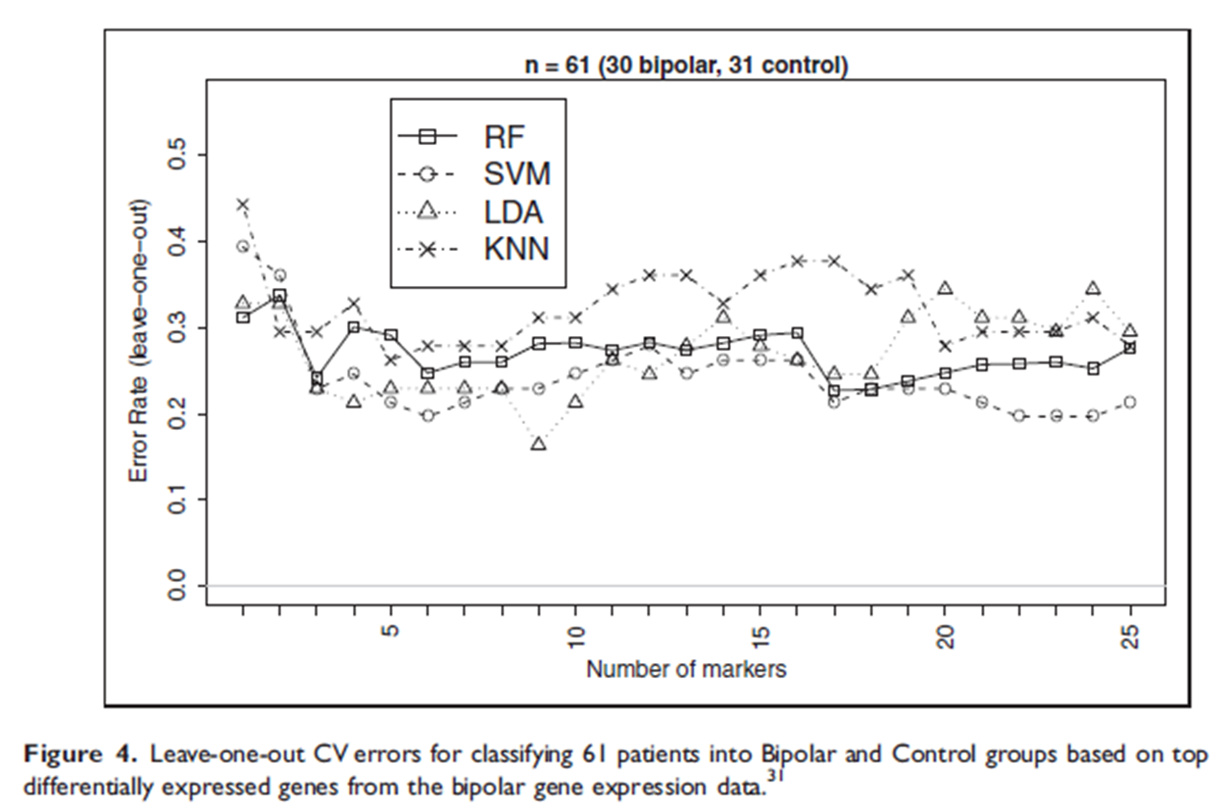
Bipolar gene expression data
Notes:
Was wird gezeigt: x-axis: selected top 25 markers based on the p-values ofthe Empirical Bayes test41 for differential expression between the bipolar and control groups for
classification analysis
Y-axis: same error type as before
Interpretation: - the classification performance does not appear to improve as the number of markers grows beyond around 5
SVM appears better (followed by LDA) in most instances ( = consistent with findings on simulated data)
performance of LDA started to deteriorate when the number of markers exceeded 18 which is much smaller than the threshold (n/2 =30) predicted from simulation studies
For the other real datasets they performed the same steps and find in the resulting plot one or pattern that matches one of the findings found in the simulated data and thus confirms it.

Slide 13
Conclusions
Goal: Find guideline for: ‘which method performs better in what circumstances’
Clusterin approach | Findings
LDA | Good for smaller number of correlated features (correlation > 0.6), number of features not exceeding ~ n/2 Method of choice according average gerneralisation erros + stability (precision)
SVM | Larger feature sets → outplays all others with highest margin of performance differences at higher data variability, smaller effect size and smaller correlation Sample size at least n = 20
kNN | Improved performence with growing feature set size (unless data variability is too high and/or effect sizes are too small)
Random Forest | Outperform only kNN where data were more variable and had smaller effect sizes

